Slide 1
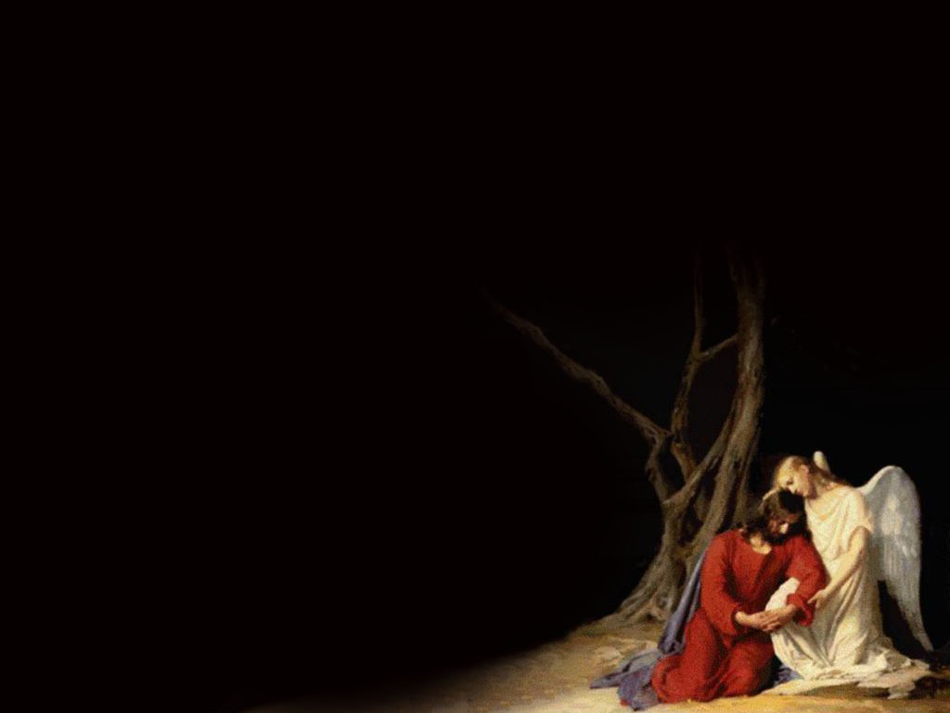
ព្រះគុណអស្ចារ្យ Amazing grace (My Chains Are Gone )

Slide 2
Amazing grace how sweet the sound, that saved a wretch like me. I once was lost but now am found, was blind but now I see.

Slide 3
T’was grace that taught, my heart to fear, and grace my fears relieved; How precious did that grace appear, the hour I first believed

Slide 4
My chains are gone I’ve been set free My God my savior has ransomed me And like a flood His mercy reigns Unending love amazing grace

Slide 5
The Lord has promised good to me His word my hope secures He will my shield and portion be As long as life endures

Slide 6
The earth shall soon dissolve like snow The sun forbear to shine But God who called me here below Will be forever mine Will be forever mine You are forever mine

Slide 7
៣.​ Amazing grace Amazing grace how sweet the sound, that saved a wretch like me. I once was lost but now am found, was blind but now I see. T’was grace that taught, my heart to fear, and grace my fears relieved; How precious did that grace appear, the hour I first believed My chains are gone I’ve been set free My God my savior has ransomed me And like a flood His mercy reigns Unending love amazing grace The Lord has promised good to me​ ​​His word my hope secures He will my shield and portion be As long as life endures The earth shall soon dissolve like snow The sun forbear to shine But God who called me here below Will be forever mine Will be forever mine You are forever mine

