Slide 1
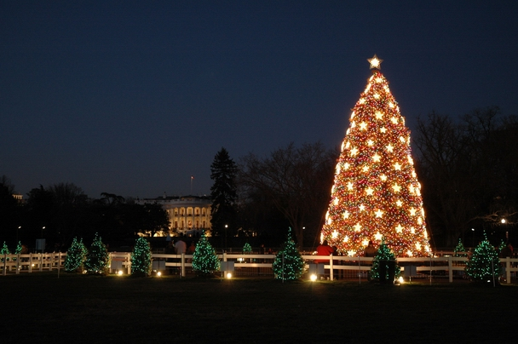
平安夜
Silent Night

Slide 2
យប់ដ៏សុខសាន្ត យប់បរិសុទ្ធ
ស្ងប់ស្ងាត់ឈឹងស្រួលបំផតុ
នៅជុំវិញព្រះរាជបុត្រា

Slide 3
ជាបុត្របរិសុទ្ធ ទន់ភ្លន់អស្ចារ្យ
សូមផ្ទុំលក់ដោយសុខសាន្ត
សូមផ្ទុំលក់ដោយសុខសាន្ត

Slide 4
Silent night! Holy night!
All is calm, all is bright,
Round yon virgin mother and Child.
Holy infant, so tender and mild,
Sleep in heavenly peace,
Sleep in heavenly peace.

Slide 5
Silent night! Holy night! Son of God,
love’s pure light, Rad’ant beams from Thy holy Face,
with the dawn of redeeming grace,
Jesus, Lord, at Thy birth,
Jesus, Lord, at Thy birth.

Slide 6
平 安 夜, 圣 善 夜，
ping an ye, sheng shan ye,
万 暗 中， 光 华 射
wan an zhong, guang hua she
照 着 圣 母 也 照 着
zhao zhe sheng mu ye zhao zhe

Slide 7
圣 婴， 多 少 慈 祥
sheng ying, duo shao ci xiang
也 多 少 天 真，
ye duo shao tian zhen,
尽 享 天 赐 安 眠，
jin xiang tian ci an mian.
尽 享 天 赐 安 眠。
jin xiang tian ci an mian.

Slide 8
平 安 夜， 圣 善 夜,
ping an ye, sheng shan ye,
神 子爱, 光 皎 洁，
Shen zi ai, guang jiao jie,
这 是 救 恩 黎 明 光 芒，
zhe shi jiu en li ming guang mang,

Slide 9
救 赎 恩 典 降 临 四 方，
jiu shu en dian jiang lin si fang,
主 耶 稣 今 降 生，
Zhu Yesu jin jiang sheng,
主 耶 稣 今 降 生。
Zhu Yesu jin jiang sheng,

