Slide 1
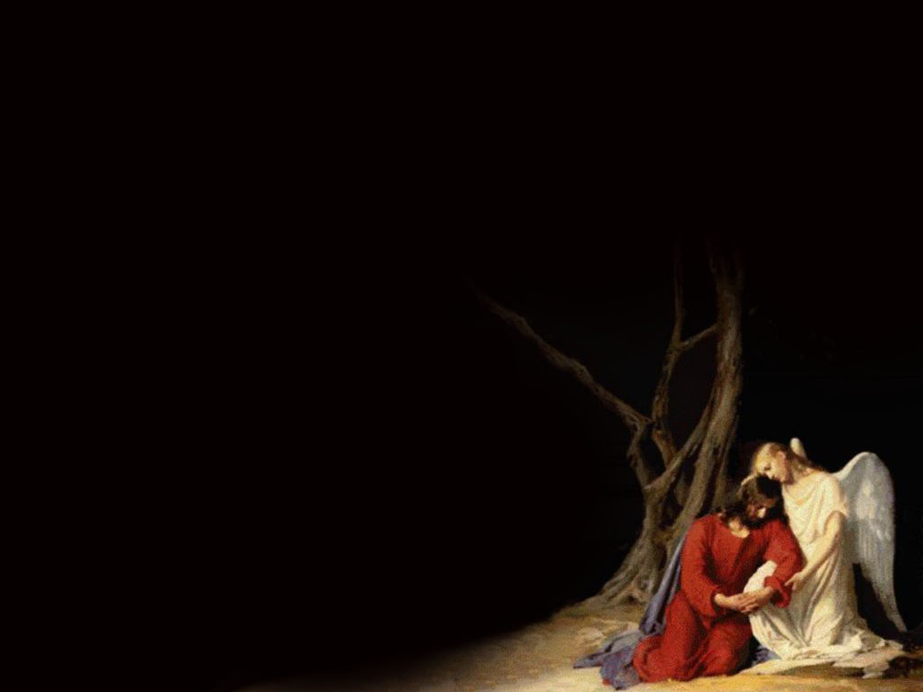
You Raise Me Up

Slide 2
When I am down and,
oh my soul so weary; when troubles come and my heart burdened be;

Slide 3
Then, I am still and wait here in the silence,
Until you come and sit awhile with me.

Slide 4
You raise me up,
so I can stand on mountains;
You raise me,
Up to walk on stormy seas;

Slide 5
I am strong,when
I am on your shoulders;
You raise me up
To more than I can be.

